Slide 1






TECHNOLOGY TREND – PRESENT AND FUTURE

Slide 2



OUTLINE
Executive Summary
Introduction
Methodology
Results
Visualization – Charts
Dashboard
Discussion
Findings & Implications
Conclusion
Appendix

Slide 3

EXECUTIVE SUMMARY
Trends in Current Technology Usage
Language
Data Base
Platform
Web Frame
Predicted Trends in Future Technology Usage
Language
Data Base
Platform
Web Frame
Demographic Survey
Country & Gender Difference

Slide 4

INTRODUCTION
Analyzing the Technology trend among the developers world-wide.
Purpose of the Analysis:
Identifying the in-demand top programming languages, databases, platforms and web frames.
Identifying required skills for future
Identifying the Industrial Human Resource gap
Targeted Audience:
Programmers
IT industry leaders
Computer science students

Slide 5

METHODOLOGY
Sources of Data Collection
The 2019 Stack Overflow Developer Survey
API Job Posting
Programming Language Annual Salary
Data Wrangling
Data Exploration
Data Cleaning
Data Visualization
IBM Cognos Analytics
Presentation

Slide 6
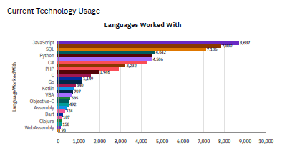
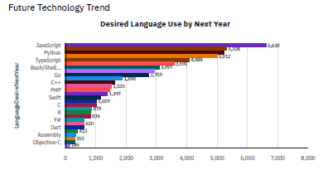
PROGRAMMING LANGUAGE TRENDS

Slide 7
PROGRAMMING LANGUAGE TRENDS - FINDINGS & IMPLICATIONS
Current Year
Next Year
JavaScript is trending as the top most demanding language world-wide.
Python, SQL and C# are other popular languages.
C# is more desirable than C language.
JavaScript is still the top most demanding language world-wide.
Python's demand will increase in the near future and may surpass JavaScript.
Typescript is more desirable than Bash/Shell/PowerShell.

Slide 8
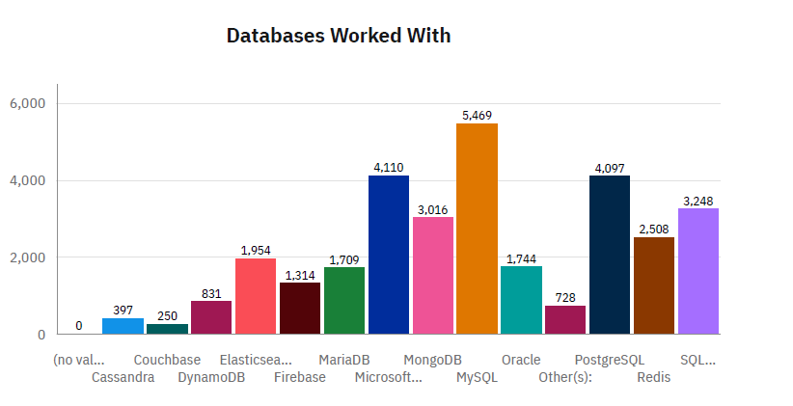
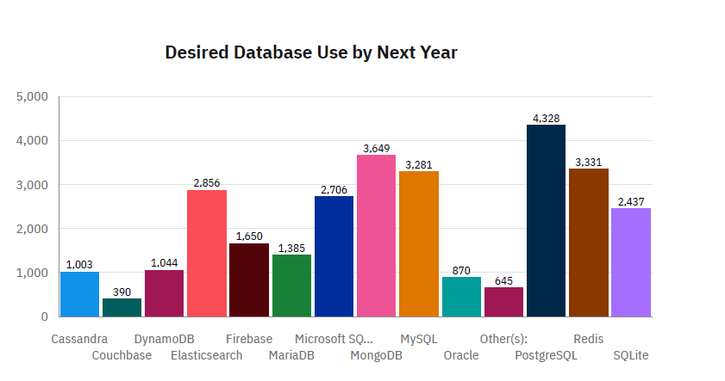
DATABASE TRENDS

Slide 9
DATABASE TRENDS - FINDINGS & IMPLICATIONS
Current Year
Next Year
MySQL is the top most popular database world-wide.
Microsoft SQL Server and PostgreSQL are other most popular databases.
MongoDB and Redis are considered the most favorable NoSQL databases.
PostgreSQL has surpassed MySQL to become the most popular database world-wide.
MySQL is still one of the most popular databases world-wide.
Open source databases are preferred more.

Slide 10

DASHBOARD
https://github.com/ighoshal/testrepo1/blob/main/Final%20Assessment%20Dashboard.pdf

Slide 11
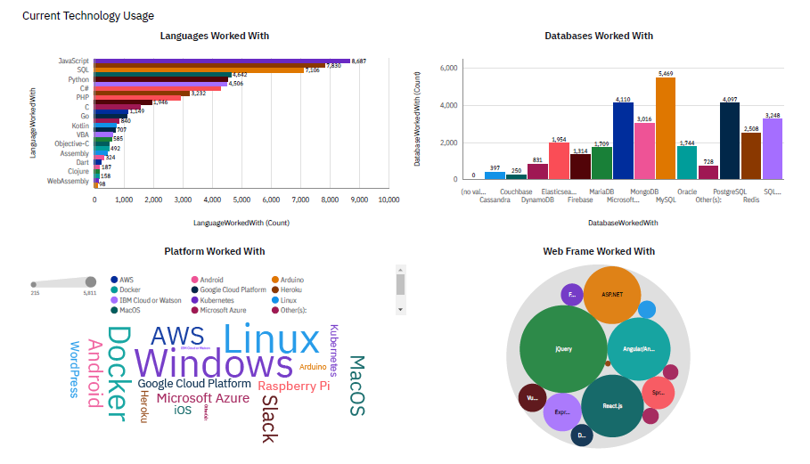
DASHBOARD TAB 1

Slide 12
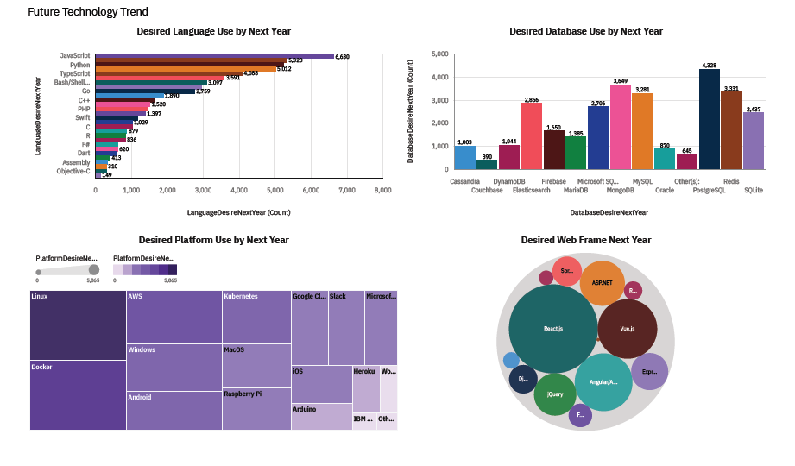
DASHBOARD TAB 2

Slide 13
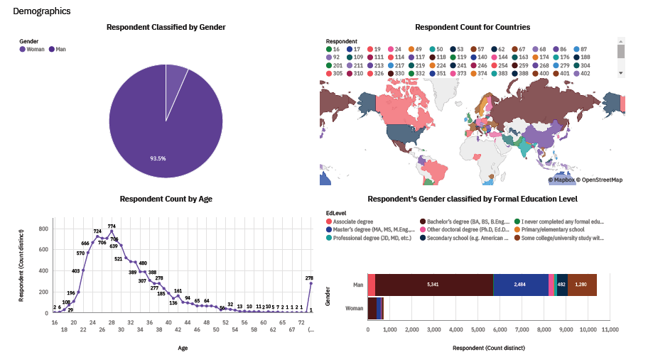
DASHBOARD TAB 3

Slide 14

DISCUSSION
Trends in Technology Usage - Current and Future.
Discrimination based on Gender, Age and Education in the IT Industry.

Slide 15
OVERALL FINDINGS & IMPLICATIONS
Findings
Trends and demands change every year.
Java script and Python are the most popular languages and MySQL and PostgreSQL are the most popular databases.
There is extreme discrimination based on Gender and Age.
Implications
Programmers consistently need to follow the latest trends in the technology.
Higher proficiency in demanded skill leads to more opportunity.
Employment benefits should not be based on Gender and Age.

Slide 16

CONCLUSION
Demands and trends are affected by new technologies.
Java script and Python are the most popular languages and MySQL and PostgreSQL are the most popular databases.
There is a need of diversity in the IT Industry.

Slide 17

APPENDIX
The 2019 Stack Overflow Developer Survey: https://stackoverflow.blog/2019/04/09/the-2019-stack-overflow-developer-survey-results-are-in/

Slide 18
THANK YOU

